Slide 2
Overview
Part 1 – The Design Space
Part 2 – Propagation Delay and Timing
  Propagation Delay
  Delay Models
  Cost/Performance Tradeoffs
  Flip-Flop Timing
  Circuit & System Level Timing
Part 3 – Asynchronous Interactions
Part 4 - Programmable Implementation Technologies

Slide 3
Propagation Delay
Propagation delay is the time for a change on an input of a gate to propagate to the output.
Delay is usually measured at the 50% point with respect to the H and L output voltage levels.
High-to-low (t_{PHL}) and low-to-high (t_{PLH}) output signal changes may have different propagation delays.
High-to-low (HL) and low-to-high (LH) transitions are defined with respect to the output, not the input.
An HL input transition causes:
  an LH output transition if the gate inverts and
  an HL output transition if the gate does not invert.

Slide 4
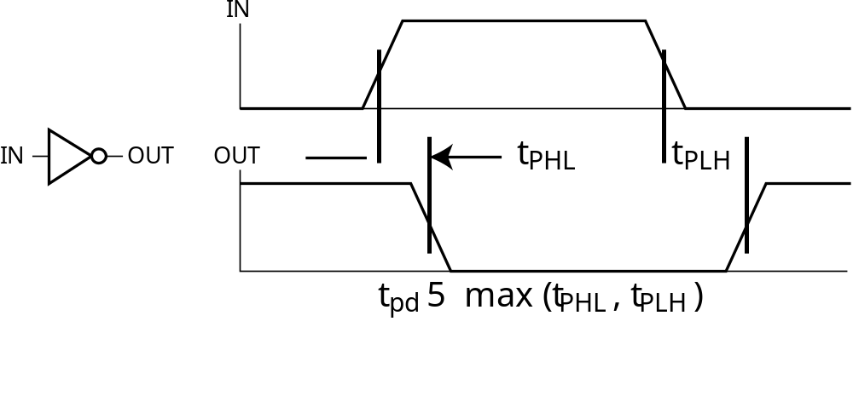
Propagation Delay (continued)
Propagation delays measured at the midpoint between the L and H values
What is the expression for the t_{PHL} delay for:
  a string of n identical buffers?
  a string of n identical inverters?

Slide 5
Propagation Delay Example
Find t_{PHL}, t_{PLH} and t_{pd} for the signals given
IN (volts)
OUT (volts)
t (ns)
1.0 ns per division
Notes:
t_{PHL} = 1.4 ns, t_{PLH} = 1.1 ns, t_{pd} = 1.25 ns

Slide 6
Delay Models
Transport delay - a change in the output in response to a change on the inputs occurs after a fixed specified delay
Inertial delay - similar to transport delay, except that if the input changes such that the output is to change twice in a time interval less than the rejection time, the output changes do not occur. Models typical electronic circuit behavior, namely, rejects narrow “pulses” on the outputs

Slide 7
Delay Model Example
A
B
A B:
No Delay
(ND)
a
b
c
d
e
Transport
Delay (TD)
Inertial
Delay (ID)
0
2
4
6
8
10
12
14
16
Time (ns)
Propagation Delay = 2.0 ns Rejection Time = 1 .0 ns

Slide 8
Circuit Delay
Suppose gates with delay n ns are represented for n = 0.2 ns, n = 0.4 ns,
n = 0.5 ns, respectively:
0.2
0.4
0.5

Slide 9
Circuit Delay
A
Consider a simple 2-input multiplexer:
With function:
  Y = A for S = 1
  Y = B for S = 0
“Glitch” is due to delay of inverter
0.4
0.2
Y
0.5
S
B
0.4
A
B
S
S
Y

Slide 10
Fan-out and Delay
The fan-out loading a gate’s output affects the gate’s propagation delay
Example:
  One realistic equation for t_{pd} for a NAND gate with 4 inputs is:
    t_{pd} = 0.07 + 0.021 SL ns
  SL is the number of standard loads the gate is driving, i. e., its fan-out in standard loads
  For SL = 4.5, t_{pd} = 0.165 ns
If this effect is considered, the delay of a gate in a circuit takes on different values depending on the circuit load on its output.

Slide 11
Cost/Performance Tradeoffs
Gate-Level Example:
  NAND gate G with 20 standard loads on its output has a delay of 0.45 ns and has a normalized cost of 2.0
  A buffer H has a normalized cost of 1.5. The NAND gate driving the buffer with 20 standard loads gives a total delay of 0.33 ns
  In which if the following cases should the buffer be added?
    The cost of this portion of the circuit cannot be more than 2.5
    The delay of this portion of the circuit cannot be more than 0.40 ns
    The delay of this portion of the circuit must be less than 0.30 ns and the cost less than 3.0
Tradeoffs can also be accomplished much higher in the design hierarchy
Constraints on cost and performance have a major role in making tradeoffs
Notes:
1. No buffer
2. Use buffer
3. Irrelevant - buffer needed to satisfy delay constraint, but cannot satisfy cost constraint.

Slide 12






Flip-Flop Timing Parameters
t_{s} - setup time
t_{h} - hold time
t_{w} - clock
pulse width
t_{px} - propa-
gation delay
  t_{PHL} - High-to-
  Low
  t_{PLH} - Low-to-
  High
  t_{pd} - max (t_{PHL},
  t_{PLH})
t
wH
$
t
wH,min
C
t
wL
$
t
wL,min
t
s
t
h
S
/
R
t
p-,min
t
p-,max
Q
(a) Pulse-triggered (positive pulse)
t
wH
$
t
wH,min
C
t
wL
$
t
wL,min
t
s
t
h
D
t
p-,min
t
p-,max
Q
(b) Edge-triggered (negative edge)

Slide 13
Flip-Flop Timing Parameters
t_{s} - setup time
  Master-slave - Equal to the width of the triggering pulse
  Edge-triggered - Equal to a time interval that is generally much less than the width of the the triggering pulse
t_{h} - hold time - Often equal to zero
t_{px} - propagation delay
  Same parameters as for gates except
  Measured from clock edge that triggers the output change to the output change

Slide 14
Circuit and System Level Timing
Consider a system
comprised of ranks
of flip-flops
connected by logic:
If the clock period is
too short, some
data changes will not
propagate through the
circuit to flip-flop
inputs before the setup
time interval begins
D
Q
D
Q
C
Q'
C
Q'
D
Q
D
Q
C
Q'
C
Q'
D
Q
D
Q
C
Q'
C
Q'
D
Q
D
Q
C
Q'
C
Q'
D
Q
D
Q
C
Q'
C
Q'
CLOCK
CLOCK

Slide 15
Circuit and System Level Timing
New Timing Components
  t_{p} - clock period - The interval between occurrences of a specific clock edge in a periodic clock
  t_{pd,COMB} - total delay of combinational logic along the path from flip-flop output to flip-flop input
  t_{slack} - extra time in the clock period in addition to the sum of the delays and setup time on a path
    Can be either positive or negative
    Must be greater than or equal to zero on all paths for correct operation

Slide 16
Circuit and System Level Timing
Timing components along a path from flip-flop to flip-flop
t
p
C
t
pd,FF
t
pd,COMB
t
s
t
slack
(a) Edge-triggered (positive edge)
t
p
C
t
pd,FF
t
pd,COMB
t
t
slack
s
(b) Pulse-triggered (negative pulse)

Slide 17
Circuit and System Level Timing
Timing Equations
t_{p} = t_{slack} + (t_{pd,FF} + t_{pd,COMB} + t_{s})
  For t_{slack} greater than or equal to zero,
  t_{p} ≥ max (t_{pd,FF} + t_{pd,COMB} + t_{s})
  for all paths from flip-flop output to flip-flop input
Can be calculated more precisely by using t_{PHL} and t_{PLH} values instead of t_{pd} values, but requires consideration of inversions on paths

Slide 18
Calculation of Allowable t_{pd,COMB}
Compare the allowable combinational delay for a specific circuit:
a) Using edge-triggered flip-flops
b) Using master-slave flip-flops
Parameters
  t_{pd,FF}(max) = 1.0 ns
  t_{s}(max) = 0.3 ns for edge-triggered flip-flops
  t_{s} = t_{wH} = 1.0 ns for master-slave flip-flops
  Clock frequency = 250 MHz

Slide 19
Calculation of Allowable t_{pd,COMB}
Calculations: t_{p} = 1/clock frequency = 4.0 ns
  Edge-triggered: 4.0 ≥ 1.0 + t_{pd,COMB} + 0.3, t_{pd,COMB} ≤ 2.7 ns
  Master-slave: 4.0 ≥ 1.0 + t_{pd,COMB} + 1.0, t_{pd,COMB} ≤ 2.0 ns
Comparison: Suppose that for a gate, average t_{pd} = 0.3 ns
  Edge-triggered: Approximately 9 gates allowed on a path
  Master-slave: Approximately 6 to 7 gates allowed on a path

Slide 20
Terms of Use
All (or portions) of this material © 2008 by Pearson Education, Inc.
Permission is given to incorporate this material or adaptations thereof into classroom presentations and handouts to instructors in courses adopting the latest edition of Logic and Computer Design Fundamentals as the course textbook.
These materials or adaptations thereof are not to be sold or otherwise offered for consideration.
This Terms of Use slide or page is to be included within the original materials or any adaptations thereof.

